Slide 1
Chapter 8. Joint Exploration Model (JEM) for Versatile Video Coding (H.266)

Slide 2
Outline
JEM Coding Algorithm and Feature Summary
Quadtree Plus Binary Tree Block Structure
Intra Prediction
Inter Prediction
Transform
Loop Filters
Entropy Coding
Coding Performance and Complexity

Slide 3
Introduction
JEM applies the classic block-based hybrid video coding architecture which exploits inter-picture prediction to minimize temporal statistical redundancy, intra-picture prediction to reduce spatial statistical redundancy, transform coding of the prediction residual signals to further reduce spatial statistical redundancy, and in-loop filters to attenuate compression artifacts.

Slide 4
Block partitioning
The biggest advantage of HEVC over AVC is using the quadtree splitting coding unit (CU) partitioning structure with maximum CU size up to 64×64 luma samples, instead of 16×16 macroblocks in AVC.
In JEM, a partitioning scheme using a quadtree splitting with a nested binary-tree splitting is employed. CU can be either of square or of rectangular shape.
The coding tree unit (CTU) size is enlarged up to 256×256 luma samples. JEM also provides the ability for the luma and chroma components to have separate block partitioning structures.

Slide 5
Intra prediction
HEVC uses 35 intra prediction modes, including planar, reference sample averaging (DC mode), and 33 directional angular modes.
JEM employs a set of 65 directional angular modes and a “most probable modes” list with 6 candidates to efficiently code the selection among 67 intra prediction modes.
Two sets of 4-tap interpolation filters with different frequency cutoffs and 1/32 pixel precision are used to generate the prediction samples located at fractional positions for the angular modes.

Slide 6
Intra prediction (cont.)
In HEVC, a filtering process is applied on boundary samples of horizontal and vertical prediction modes.
JEM employs boundary filtering to 45° diagonal and adjacent modes, as well as adjacent modes of horizontal and vertical modes with position-dependent intra prediction combination (PDPC).
Additionally, a linear cross-component prediction improves the prediction efficiency of chroma components, utilizing the previously decoded structure of the luma component.

Slide 7
Inter prediction
JEM retains two motion information coding methods from HEVC: a merge mode inheriting the motion vectors (MVs) from temporally or spatially neighboring prediction blocks, and the advanced MV prediction (AMVP) mode using motion information from temporally or spatially neighboring prediction blocks as predictors to code the current MV.
JEM introduces subblock based MV prediction, in which the current CU is divided into equal-sized subblocks.
JEM increases the MV precision from 1/4 sample to 1/16 sample, and a block-based four parameter affine transform motion model is used to represent higher-order motion, such as scaling and rotation.

Slide 8
Inter prediction (cont.)
In JEM, overlapped block motion compensation (OBMC) is used to improve the prediction quality of block boundaries, and local illumination motion compensation (LIC) is applied to the videos with local light changes or fading sequences.

Slide 9
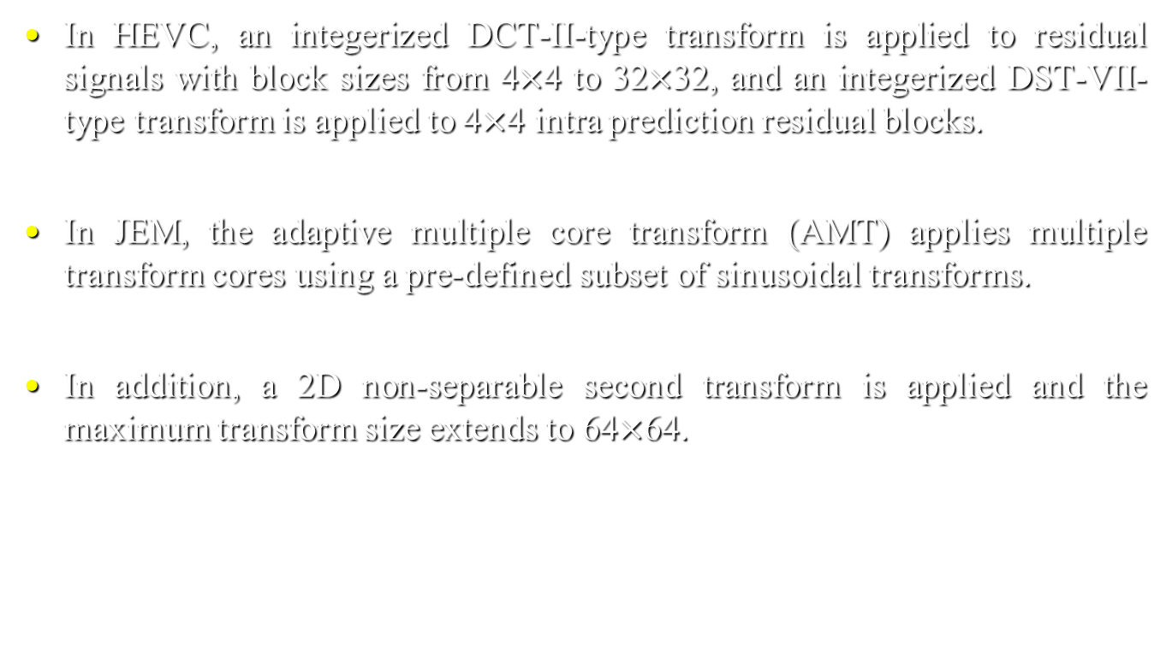
Transforms
In HEVC, an integerized DCT-II-type transform is applied to residual signals with block sizes from 4$×$4 to 32$×$32, and an integerized DST-VII- type transform is applied to 4$×$4 intra prediction residual blocks.
In JEM, the adaptive multiple core transform (AMT) applies multiple transform cores using a pre-defined subset of sinusoidal transforms.
In addition, a 2D non-separable second transform is applied and the maximum transform size extends to 64$×$64.

Slide 10
Entropy coding and in-loop filters
In JEM, context adaptive binary arithmetic coding (CABAC) is used with two improvements: multi-hypothesis probability models with different probability updating speeds are employed and the transform coefficients are coded with an optimized context model selection.
In JEM, four in-loop filters, namely, bilateral filter, deblocking filter, sample adaptive offset (SAO) filter, and adaptive loop filter (ALF) are applied in sequential order, where SAO and deblocking filters are the same as those in HEVC.

Slide 11
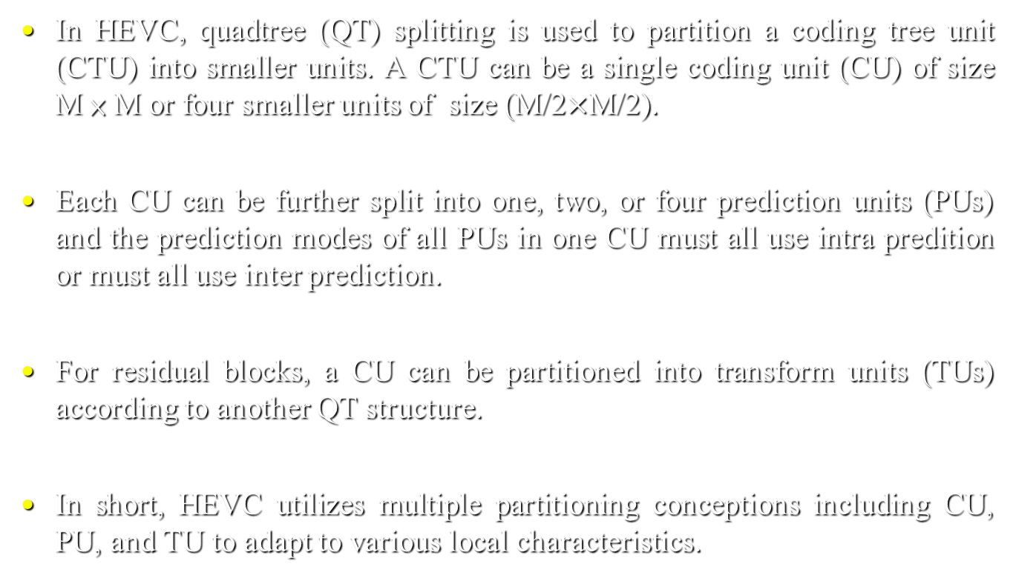
Quadtree plus binary tree block structure
In HEVC, quadtree (QT) splitting is used to partition a coding tree unit (CTU) into smaller units. A CTU can be a single coding unit (CU) of size M × M or four smaller units of size (M/2$×$M/2).
Each CU can be further split into one, two, or four prediction units (PUs) and the prediction modes of all PUs in one CU must all use intra predition or must all use inter prediction.
For residual blocks, a CU can be partitioned into transform units (TUs) according to another QT structure.
In short, HEVC utilizes multiple partitioning conceptions including CU, PU, and TU to adapt to various local characteristics.

Slide 12
Quadtree plus binary tree block structure (cont.)
In JEM, a quadtree plus binary tree (QTBT) splitting is employed, which supports more flexibility for CU partition shapes, e.g., square or rectangular shape.
The solid lines indicate QT splitting and dotted lines indicate binary tree (BT) splitting and there are two types in BT splitting, horizontal splits and vertical splits.
The BT leaf nodes are called CUs, and one CU is one PU or one TU with the same block size.
In JEM, luma and chroma components may have separate QTBT structures.

Slide 13
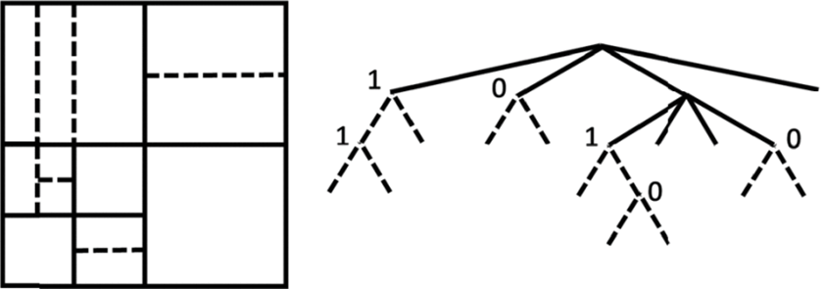
Quadtree plus binary tree block structure (cont.)
In JEM, CTUSize can be up to 256×256 luma samples, but in HEVC, the maximum CTU size is only 64×64 luma samples.
(a)
(b)
Block partitioning (a) and tree representation (b) using QTBT.

Slide 14
Intra prediction
There are four prediction mode types: planar, DC, angular directional, and cross-component linear model (CCLM).
Interpolation filters are used for deriving predicted samples, position dependent prediction combination (PDPC) is employed for the planar mode, and secondary boundary filtering is applied to diagonal and adjacent modes, as well as adjacent horizontal and vertical modes.

Slide 15
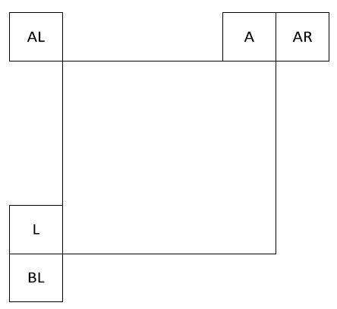
Intra mode coding with 67 intra prediction modes
In JEM, the number of directional intra modes is extended from 33 in HEVC to 65 [11] and the number of designated most probable modes (MPMs) is also increased from 3 in HEVC to 6.

Slide 16
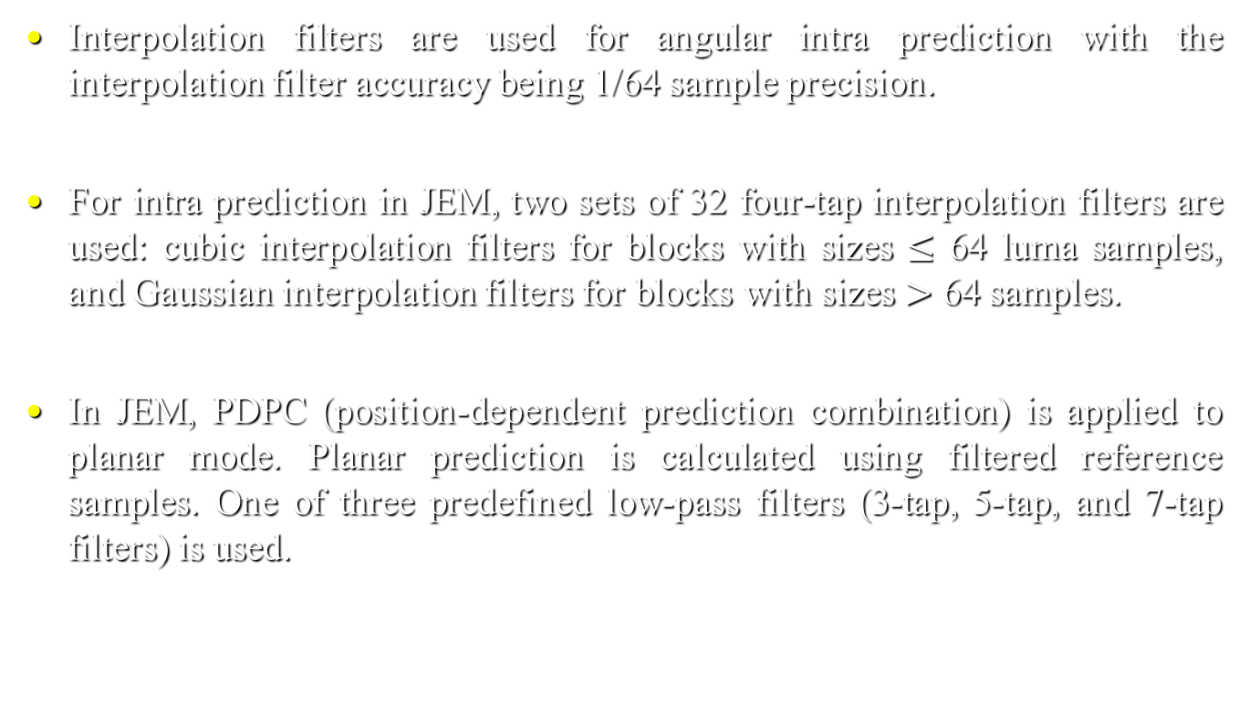
Four-tap intra interpolation filter
Interpolation filters are used for angular intra prediction with the interpolation filter accuracy being 1/64 sample precision.
For intra prediction in JEM, two sets of 32 four-tap interpolation filters are used: cubic interpolation filters for blocks with sizes $≤$ 64 luma samples, and Gaussian interpolation filters for blocks with sizes $>$ 64 samples.
In JEM, PDPC (position-dependent prediction combination) is applied to planar mode. Planar prediction is calculated using filtered reference samples. One of three predefined low-pass filters (3-tap, 5-tap, and 7-tap filters) is used.

Slide 17
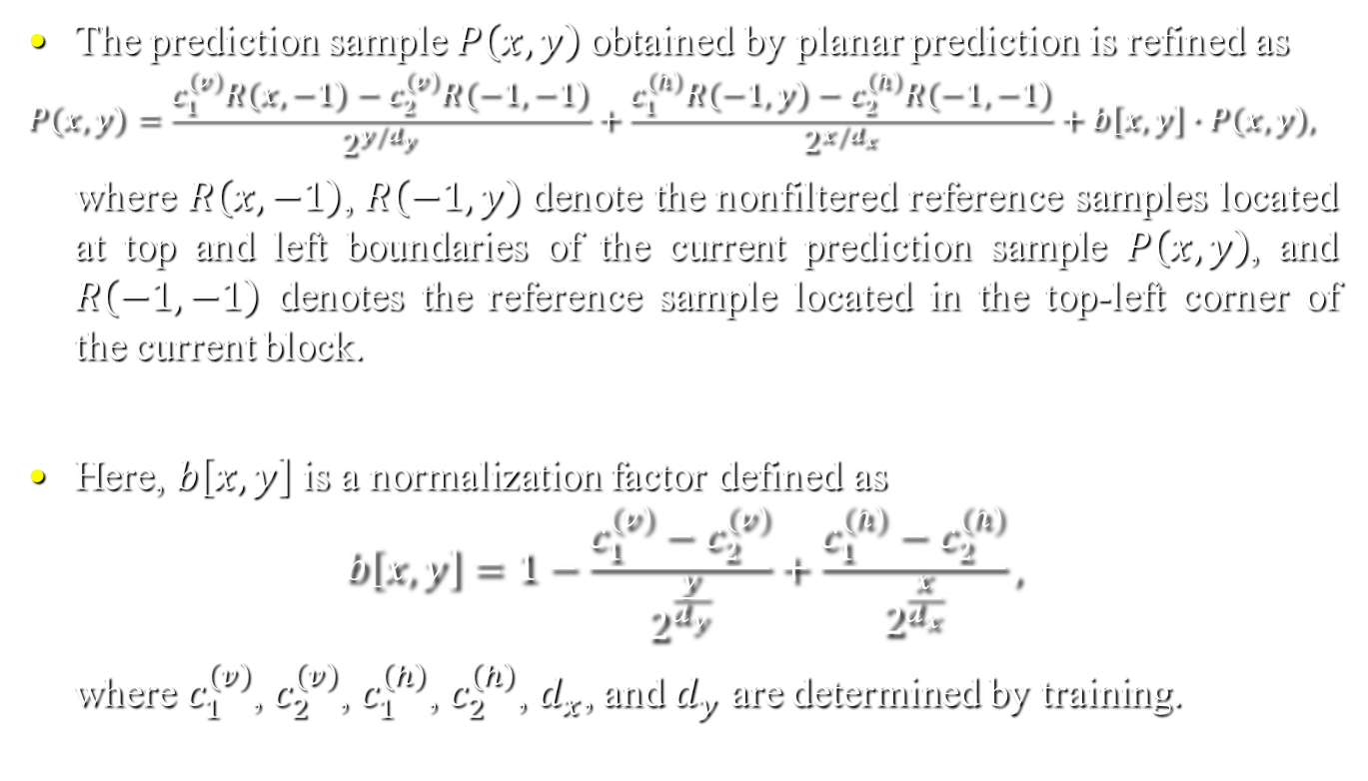
Position-dependent intra prediction combination
The prediction sample $P\left(x,y\right)$obtained by planar prediction is refined as
$$P\left(x,y\right)=\frac{c_{1}^{\left(v\right)}R\left(x,−1\right)−c_{2}^{\left(v\right)}R\left(−1,−1\right)}{2^{y/d_{y}}}+\frac{c_{1}^{\left(h\right)}R\left(−1,y\right)−c_{2}^{\left(h\right)}R\left(−1,−1\right)}{2^{x/d_{x}}}+b\left[x,y\right]∙P\left(x,y\right),$$
where $R\left(x,−1\right)$, $R\left(−1,y\right)$ denote the nonfiltered reference samples located at top and left boundaries of the current prediction sample $P\left(x,y\right)$, and $R\left(−1,−1\right)$ denotes the reference sample located in the top-left corner of the current block.
Here, $b\left[x,y\right]$ is a normalization factor defined as
$$b\left[x,y\right]=1−\frac{c_{1}^{\left(v\right)}−c_{2}^{\left(v\right)}}{2^{\frac{y}{d_{y}}}}+\frac{c_{1}^{\left(h\right)}−c_{2}^{\left(h\right)}}{2^{\frac{x}{d_{x}}}},$$
where $c_{1}^{\left(v\right)}$, $c_{2}^{\left(v\right)}$, $c_{1}^{\left(h\right)}$, $c_{2}^{\left(h\right)}$, $d_{x}$, and $d_{y}$ are determined by training.
(1)
(2)

Slide 18
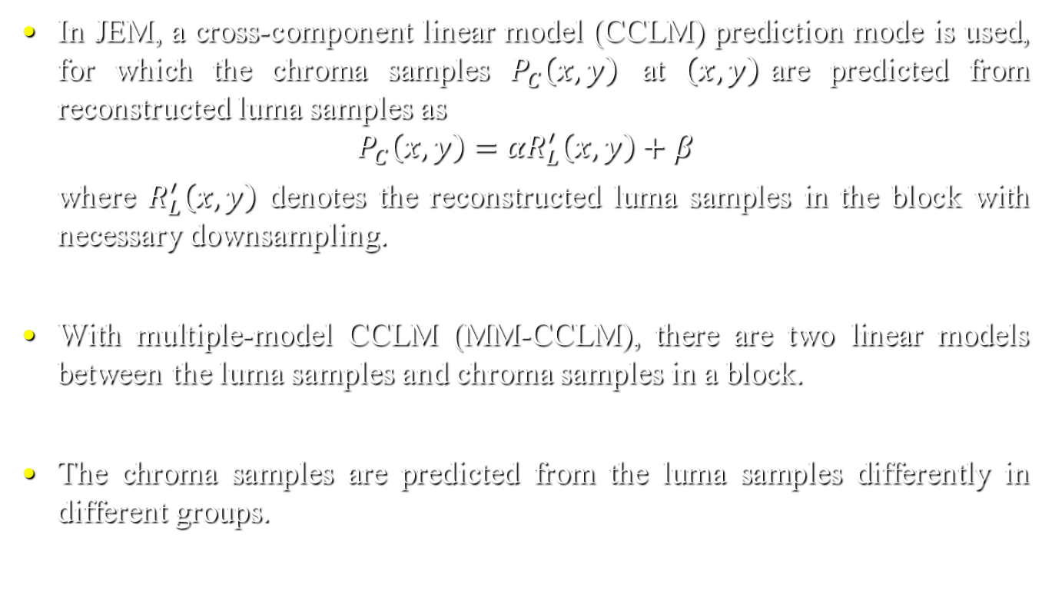
Cross-component linear model prediction
In JEM, a cross-component linear model (CCLM) prediction mode is used, for which the chroma samples $P_{C}\left(x,y\right)$ at $\left(x,y\right)$are predicted from reconstructed luma samples as
$$P_{C}\left(x,y\right)={αR}_{L}^{′}\left(x,y\right)+β$$
where $R_{L}^{′}\left(x,y\right)$ denotes the reconstructed luma samples in the block with necessary downsampling.
With multiple-model CCLM (MM-CCLM), there are two linear models between the luma samples and chroma samples in a block.
The chroma samples are predicted from the luma samples differently in different groups.
(3)

Slide 19

Cross-component linear model prediction (cont.)
Chroma samples are predicted as
$$P_{C}\left(x,y\right)=\left\{\begin{aligned}α_{1}R_{L}^{′}\left(x,y\right)+β_{1}, ifR_{L}^{′}\left(x,y\right)≤T, \\ α_{2}R_{L}^{′}\left(x,y\right)+β_{2}, ifR_{L}^{′}\left(x,y\right)>T\text{,} \end{aligned}\right.$$
where 𝑇 is calculated as the average value of the neighboring reconstructed luma samples.
(4)

Slide 20
Higher accuracy MV storage and motion compensation
In JEM, the precision for the internal MV storage and motion compensation increases from 1/4 in HEVC to 1/16 luma sample.
The higher MV precision is used in motion compensated inter prediction for the CU coded with the skip/merge mode.
In JEM, the fractional sample interpolation process for luma and chroma samples is the same as that in HEVC, which uses separable 2D interpolation filters and uses an eight-tap filter for all fractional-sample positions.
In JEM, the chroma component MV precision is 1/32 sample.

Slide 21
Subblock based motion merge
Each CU in JEM or each PU in HEVC can have at most one set of motion parameters for each prediction direction.
In JEM, two sub-block based motion merge modes are sub-block based temporal MV prediction (SbTMVP) and spatial-temporal MV prediction (STMVP).
In JEM, a CU-level adaptive MV resolution (AMVR) scheme is applied. AMVR allows MVDs of a CU to be coded in units of 1/4 luma sample, integer luma sample, or four luma samples.

Slide 22
Affine motion compensation prediction
In general, two affine motion methods: global affine motion model and local affine motion model.
In JEM, a generalized block-based affine motion prediction with four parameters is applied.
In JEM, the affine motion field for a block is described by MVs of two control points located at the top-left and top-right corners of the block.

Slide 23
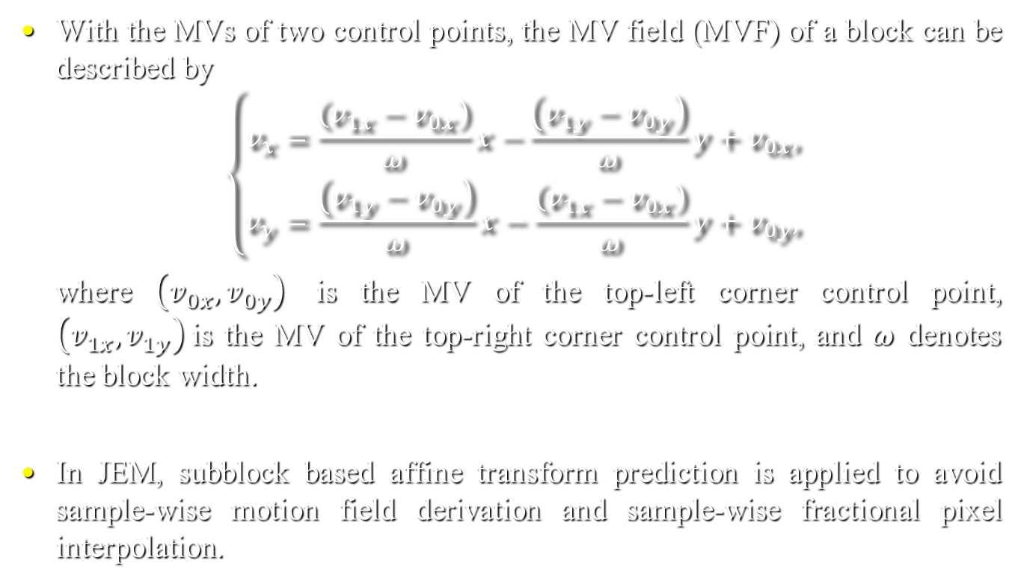
Affine motion compensation prediction (cont.)
With the MVs of two control points, the MV field (MVF) of a block can be described by
$$\left\{\begin{aligned}v_{x}=\frac{\left(v_{1x}−v_{0x}\right)}{ω}x−\frac{\left(v_{1y}−v_{0y}\right)}{ω}y+v_{0x}, \\ v_{y}=\frac{\left(v_{1y}−v_{0y}\right)}{ω}x−\frac{\left(v_{1x}−v_{0x}\right)}{ω}y+v_{0y},\end{aligned}\right.$$
where $\left(v_{0x},v_{0y}\right)$ is the MV of the top-left corner control point, $\left(v_{1x},v_{1y}\right)$is the MV of the top-right corner control point, and $ω$ denotes the block width.
In JEM, subblock based affine transform prediction is applied to avoid sample-wise motion field derivation and sample-wise fractional pixel interpolation.
(5)

Slide 24
Decoder-side motion vector refinement
In the decoder-side MV refinement (DMVR) method, the two MVs of the bi-prediction are further refined by a bilateral template matching process using the sum of absolute differences (SAD).

Slide 25
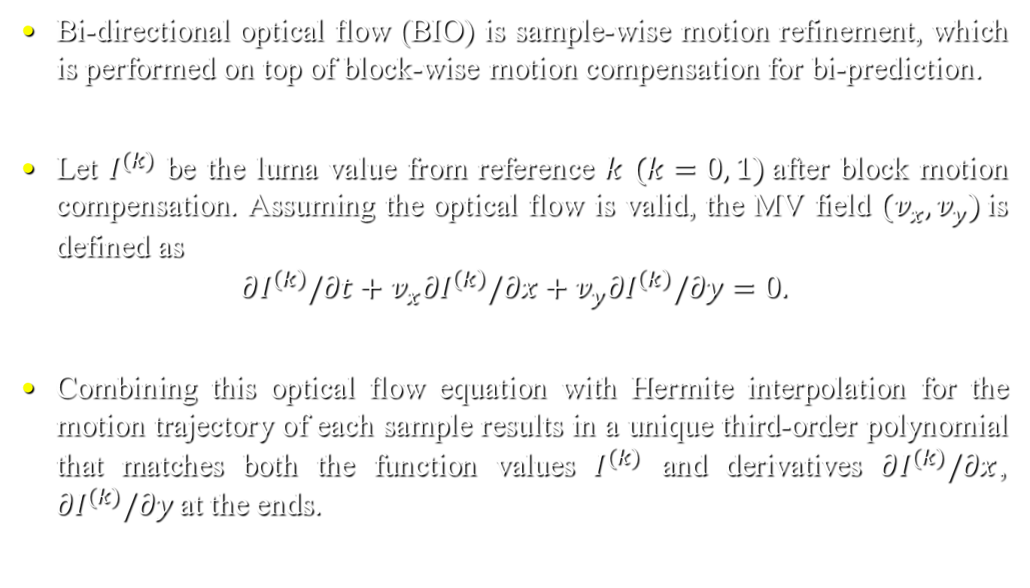
Bi-directional optical flow
Bi-directional optical flow (BIO) is sample-wise motion refinement, which is performed on top of block-wise motion compensation for bi-prediction.
Let $I^{(k)}$ be the luma value from reference $k$ $(k=0, 1)$after block motion compensation. Assuming the optical flow is valid, the MV field $(v_{x}, v_{y})$is defined as
$$∂I^{\left(k\right)}/∂t+v_{x}∂I^{\left(k\right)}/∂x+v_{y}∂I^{\left(k\right)}/∂y=0.$$
Combining this optical flow equation with Hermite interpolation for the motion trajectory of each sample results in a unique third-order polynomial that matches both the function values $I^{(k)}$ and derivatives $∂I^{(k)}/∂x$, $∂I^{(k)}/∂y$at the ends.
(8)

Slide 26
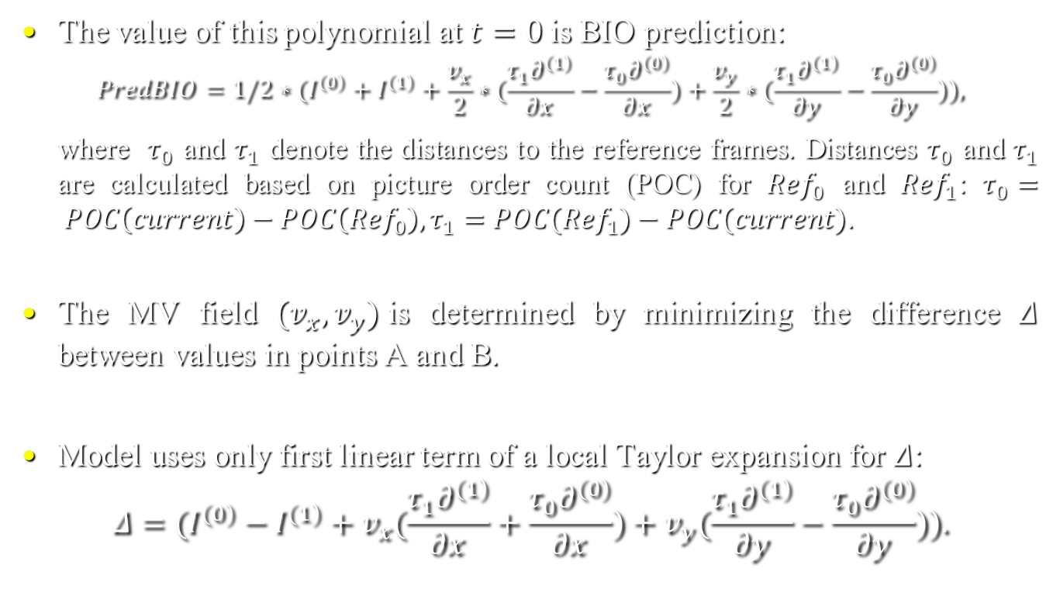
Bi-directional optical flow (cont.)
The value of this polynomial at $t=0$is BIO prediction:
$$PredBIO=1/2∗(I^{\left(0\right)}+I^{\left(1\right)}+\frac{v_{x}}{2}∗(\frac{τ_{1}∂^{\left(1\right)}}{∂x}−\frac{τ_{0}∂^{\left(0\right)}}{∂x})+\frac{v_{y}}{2}∗(\frac{τ_{1}∂^{\left(1\right)}}{∂y}−\frac{τ_{0}∂^{\left(0\right)}}{∂y})),$$
where $τ_{0}$ and $τ_{1}$ denote the distances to the reference frames. Distances $τ_{0}$ and $τ_{1}$ are calculated based on picture order count (POC) for ${Ref}_{0}$ and ${Ref}_{1}$: $τ_{0}= POC\left(current\right)−POC\left({Ref}_{0}\right), τ_{1}=POC({Ref}_{1})−POC(current)$.
The MV field $(v_{x}, v_{y})$is determined by minimizing the difference $Δ$ between values in points A and B.
Model uses only first linear term of a local Taylor expansion for $Δ$:
$$Δ=(I^{\left(0\right)}−I^{\left(1\right)}+v_{x}(\frac{τ_{1}∂^{\left(1\right)}}{∂x}+\frac{τ_{0}∂^{\left(0\right)}}{∂x})+v_{y}(\frac{τ_{1}∂^{\left(1\right)}}{∂y}−\frac{τ_{0}∂^{\left(0\right)}}{∂y})).$$
(9)
(10)

Slide 27
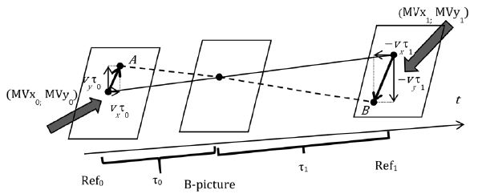

Bi-directional optical flow (cont.)
Assuming the motion is consistent in the local surrounding area, we minimize 𝛥 inside the $(2M+1)×(2M+1)$square window $Ω$ centered on the currently predicted point $(i, j)$, where $M$ is equal to 2:
$$(v_{x},v_{y})=\underset{v_{x},v_{y}}{argmin}{\sum_{\left[i,j\right]∈Ω}{Δ^{2}}\left[i^{′},j^{′}\right]}.$$
(11)

Slide 28
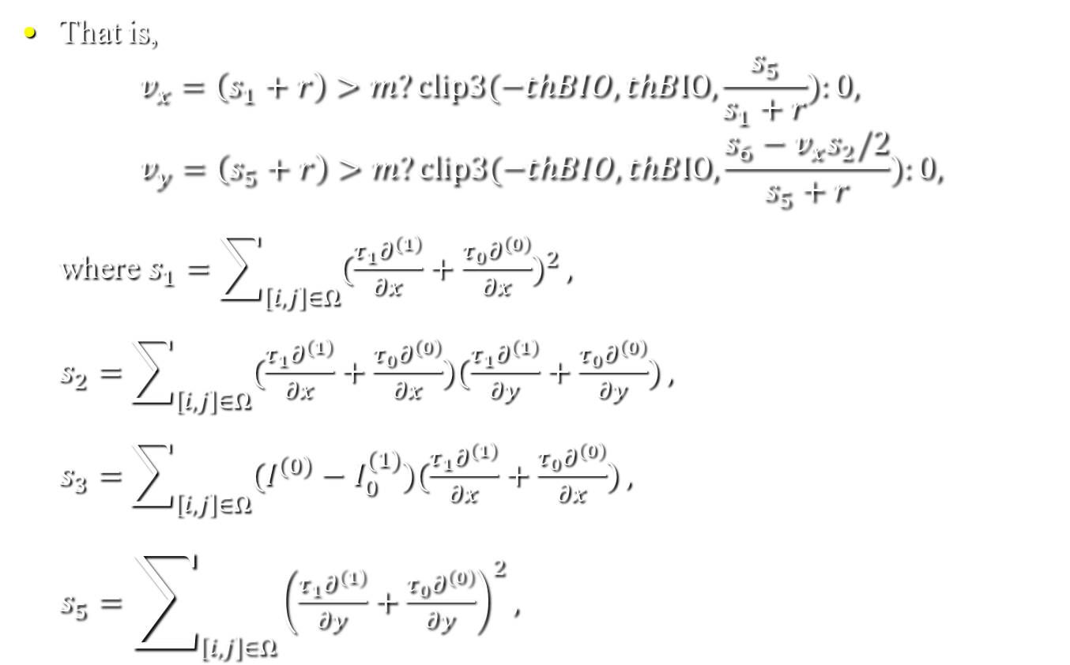
Bi-directional optical flow (cont.)
That is,
$$v_{x}=\left(s_{1}+r\right)>m?clip3(−thBIO,thBIO,\frac{s_{5}}{s_{1}+r}):0,$$
$$v_{y}=\left(s_{5}+r\right)>m?clip3(−thBIO,thBIO,\frac{s_{6}−v_{x}s_{2}/2}{s_{5}+r}):0,$$
where $s_{1}=\sum_{\left[i,j\right]∈Ω}{{(\frac{τ_{1}∂^{\left(1\right)}}{∂x}+\frac{τ_{0}∂^{\left(0\right)}}{∂x})}^{2}},$
$s_{2}=$ $\sum_{\left[i,j\right]∈Ω}{(\frac{τ_{1}∂^{\left(1\right)}}{∂x}+\frac{τ_{0}∂^{\left(0\right)}}{∂x})(\frac{τ_{1}∂^{\left(1\right)}}{∂y}+\frac{τ_{0}∂^{\left(0\right)}}{∂y})},$
$s_{3}=$ $\sum_{\left[i,j\right]∈Ω}{(I^{\left(0\right)}−I_{0}^{(1)})(\frac{τ_{1}∂^{\left(1\right)}}{∂x}+\frac{τ_{0}∂^{\left(0\right)}}{∂x})},$
$s_{5}=$ $\sum_{\left[i,j\right]∈Ω}{{\left(\frac{τ_{1}∂^{\left(1\right)}}{∂y}+\frac{τ_{0}∂^{\left(0\right)}}{∂y}\right)}^{2}},$
(12)
(13)

Slide 29
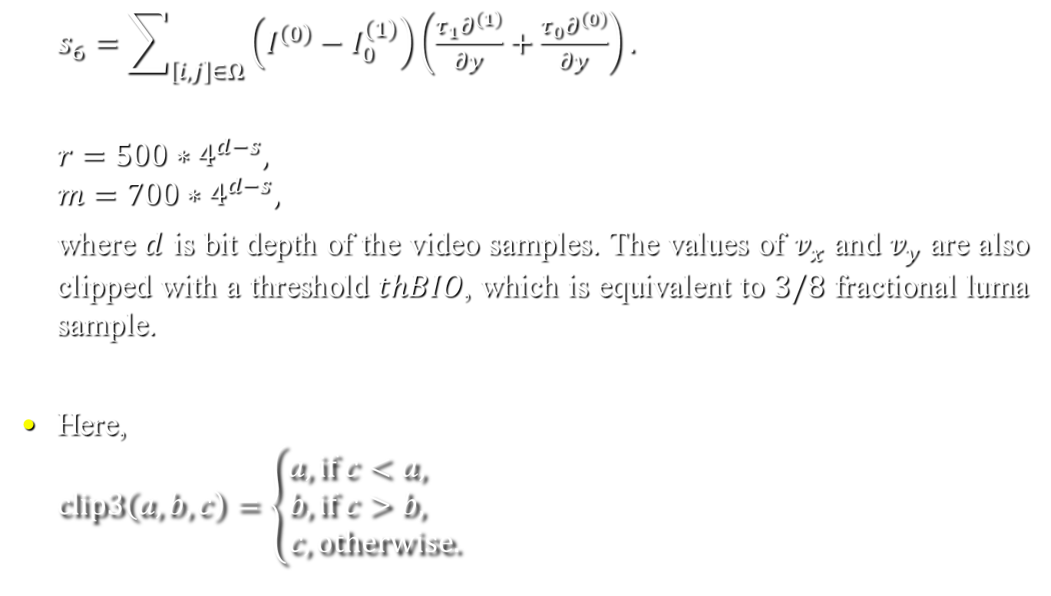
Bi-directional optical flow (cont.)
$s_{6}=$ $\sum_{\left[i,j\right]∈Ω}{\left(I^{\left(0\right)}−I_{0}^{\left(1\right)}\right)\left(\frac{τ_{1}∂^{\left(1\right)}}{∂y}+\frac{τ_{0}∂^{\left(0\right)}}{∂y}\right).}$
$$r=500∗4^{d−s},$$
$$m=700∗4^{d−s},$$
where $d$ is bit depth of the video samples. The values of $v_{x}$ and $v_{y}$ are also clipped with a threshold $thBIO$, which is equivalent to $3/8$ fractional luma sample.
Here,
$$clip3\left(a,b,c\right)=\left\{\begin{aligned}a, if c<a, \\ b, if c>b, \\ c, otherwise.\end{aligned}\right.$$
(14)
(15)
(16)

Slide 30
Pattern-matched motion vector derivation
When a block is coded with pattern-matched MV derivation (PMMVD) or decoder side MV derivation (DMVD) mode, the MV information of the block is derived at decoder only.
In JEM, two types of DMVD, i.e., template matching based DMVD and mirror based bi-directional DMVD using SAD, are applied.
By template matching, motion information of the current block is determined by finding the closest match between a template (top and left neighboring blocks) in the current picture and a corresponding area in a reference picture.
The MV of the template can be used as the MV of the current block.

Slide 31
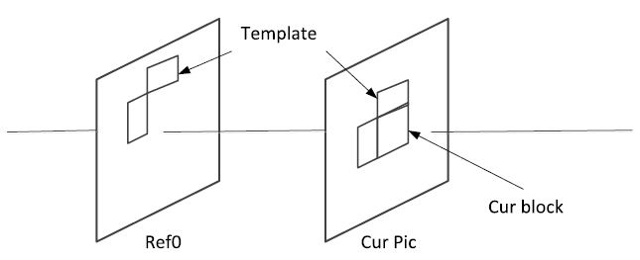
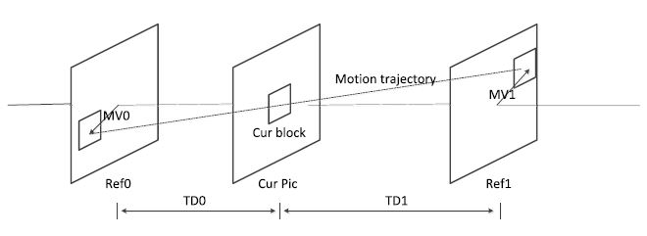
Pattern-matched motion vector derivation (cont.)
Bilateral matching is used to derive motion information of the current CU by finding the closest match between two blocks along the motion trajectory of the current CU in two different reference pictures. Bilateral matching may become mirror based bidirectional MV searching.

Slide 32
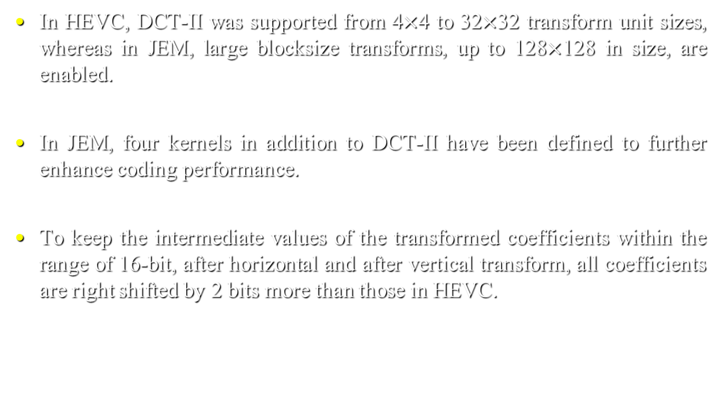
Transform
In HEVC, DCT-II was supported from 4$×$4 to 32$×$32 transform unit sizes, whereas in JEM, large blocksize transforms, up to 128$×$128 in size, are enabled.
In JEM, four kernels in addition to DCT-II have been defined to further enhance coding performance.
To keep the intermediate values of the transformed coefficients within the range of 16-bit, after horizontal and after vertical transform, all coefficients are right shifted by 2 bits more than those in HEVC.

Slide 33

Transform basis functions of DCT-II/V/VIII and DST-I/VII
transforms | basis function $T_{i}\left(j\right), i, j=0,1,…,N−1$
DCT-II | $$T_{i}\left(j\right)=ω_{0}∙\sqrt{\frac{2}{N}}∙\cos\left(\frac{π∙i∙\left(2j+1\right)}{2N}\right)$$ where $ω_{0}=\left\{\begin{aligned}\sqrt{\frac{2}{N}}, i=0 \\ 1, i≠0\end{aligned}\right.$
DCT-V | $$T_{i}\left(j\right)=ω_{0}∙ω_{1}∙\sqrt{\frac{2}{2N−1}}∙cos\left(\frac{2π∙i∙j}{2N−1}\right)$$ where $ω_{0}=\left\{\begin{aligned}\sqrt{\frac{2}{N}}, i=0 \\ 1, i≠0\end{aligned}\right.,ω_{1}=\left\{\begin{aligned}\sqrt{\frac{2}{N}}, j=0 \\ 1, j≠0\end{aligned}\right.$
DCT-VIII | $$T_{i}\left(j\right)=\sqrt{\frac{4}{2N+1}}∙cos\left(\frac{π∙(2i+1)∙(2j+1)}{4N+2}\right)$$
DST-I | $$T_{i}\left(j\right)=\sqrt{\frac{2}{N+1}}∙sin\left(\frac{π∙(i+1)∙(j+1)}{N+1}\right)$$
DST-VII | $$T_{i}\left(j\right)=\sqrt{\frac{4}{2N+1}}∙cos\left(\frac{π∙(2i+1)∙(j+1)}{2N+1}\right)$$

Slide 34
Three pre-defined transform candidate sets
transform set | transform candidates
0 | DST-VII, DCT-VIII
1 | DST-VII, DST-I
2 | DST-VII, DCT-VIII

Slide 35
Selected horizontal (H) and vertical (V) transform sets for each intra prediction mode
intra mode | 0 | 1 | 2 | 3 | 4 | 5 | 6 | 7 | 8 | 9 | 10 | 11 | 12 | 13 | 14 | 15 | 16
V | 2 | 1 | 0 | 1 | 0 | 1 | 0 | 1 | 0 | 1 | 0 | 1 | 0 | 1 | 0 | 0 | 0
H | 2 | 1 | 0 | 1 | 0 | 1 | 0 | 1 | 0 | 1 | 0 | 1 | 0 | 1 | 2 | 2 | 2
intra mode | 17 | 18 | 19 | 20 | 21 | 22 | 23 | 24 | 25 | 26 | 27 | 28 | 29 | 30 | 31 | 32 | 33
V | 0 | 0 | 0 | 0 | 0 | 0 | 1 | 0 | 1 | 0 | 1 | 0 | 1 | 0 | 1 | 0 | 1
H | 2 | 2 | 2 | 2 | 2 | 2 | 1 | 0 | 1 | 0 | 1 | 0 | 1 | 0 | 1 | 0 | 1
intra mode | 34 | 35 | 36 | 37 | 38 | 39 | 40 | 41 | 42 | 43 | 44 | 45 | 46 | 47 | 48 | 49 | 50
V | 0 | 1 | 0 | 1 | 0 | 1 | 0 | 1 | 0 | 1 | 0 | 1 | 2 | 2 | 2 | 2 | 2
H | 0 | 1 | 0 | 1 | 0 | 1 | 0 | 1 | 0 | 1 | 0 | 1 | 0 | 0 | 0 | 0 | 0
intra mode | 51 | 52 | 53 | 54 | 55 | 56 | 57 | 58 | 59 | 60 | 61 | 62 | 63 | 64 | 65 | 66
V | 2 | 2 | 2 | 2 | 1 | 0 | 1 | 0 | 1 | 0 | 1 | 0 | 1 | 0 | 1 | 0
H | 0 | 0 | 0 | 0 | 1 | 0 | 1 | 0 | 1 | 0 | 1 | 0 | 1 | 0 | 1 | 0

Slide 36
Mode-dependent non-separable secondary transforms
In JEM, a mode-dependent non-separable secondary transform (MDNSST) is applied between the forward core transform and quantization (at the encoder) and between the de-quantization and inverse core transform (at the decoder).
MDNSST is only applied to the low frequency coefficients after the primary transform.

Slide 37
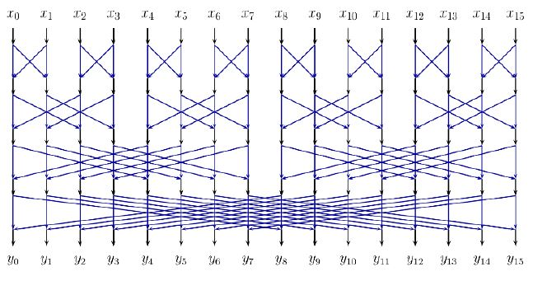
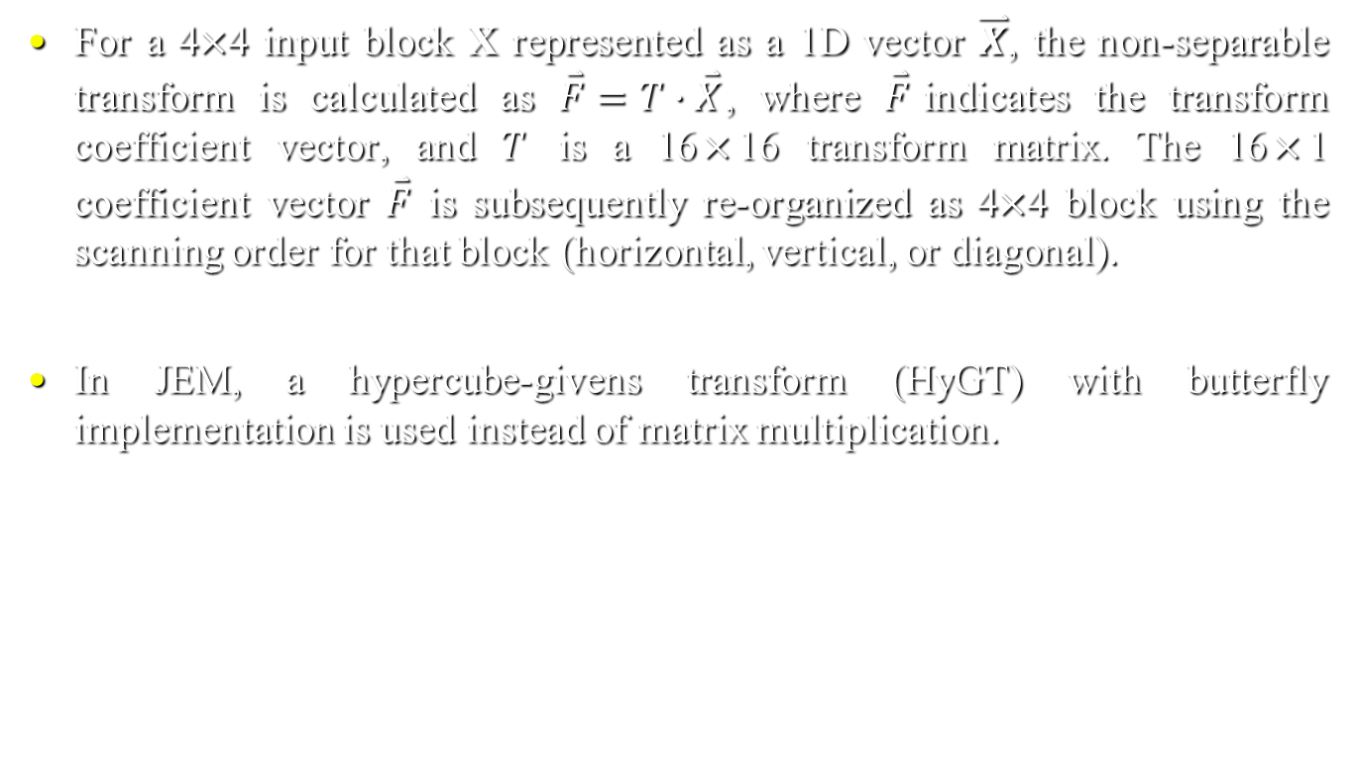
Mode-dependent non-separable secondary transforms (cont.)
For a 4$×$4 input block X represented as a 1D vector $\overset{⃑}{X}$, the non-separable transform is calculated as $\overset{⃑}{F}=T∙\overset{⃑}{X}$, where $\overset{⃑}{F}$indicates the transform coefficient vector, and $T$ is a 16$×$16 transform matrix. The 16$×$1 coefficient vector $\overset{⃑}{F}$ is subsequently re-organized as 4$×$4 block using the scanning order for that block (horizontal, vertical, or diagonal).
In JEM, a hypercube-givens transform (HyGT) with butterfly implementation is used instead of matrix multiplication.

Slide 38

Mode-dependent transform core selection
There are totally 35$×$3 non-separable secondary transforms for both 4$×$4 and 8$×$8 block sizes, where 35 is the number of transform sets specified by the intra prediction mode, and there are 3 NSST (non-separable secondary transform) candidates in each set.
In JEM, MDNSST is not applied for a block coded with transform skip mode.

Slide 39
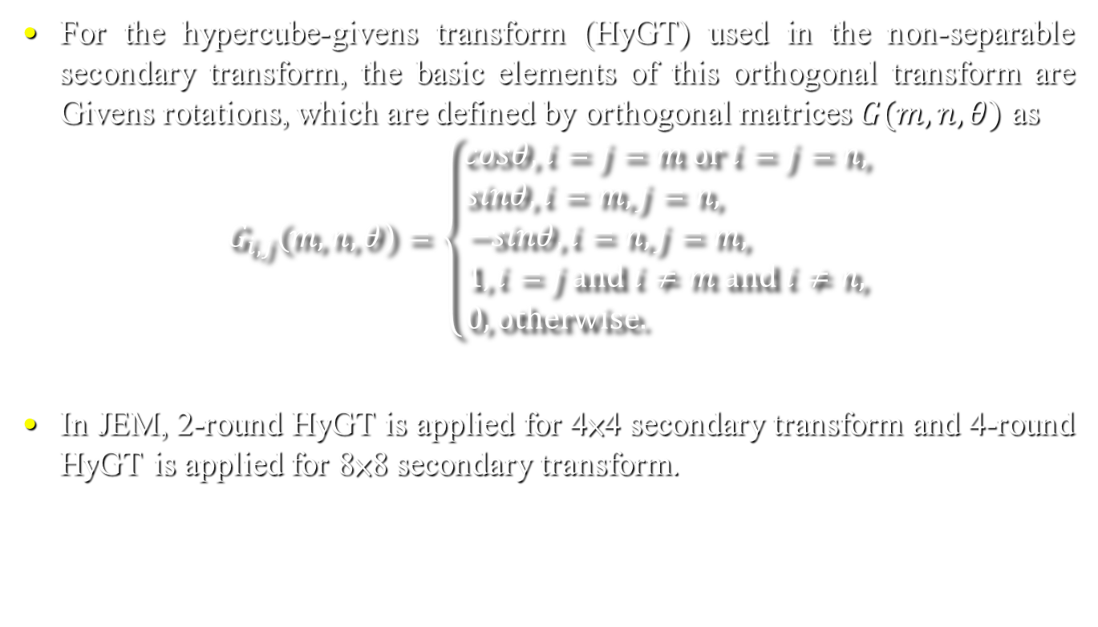
Non-separable transform based on hypercube-givens transform
For the hypercube-givens transform (HyGT) used in the non-separable secondary transform, the basic elements of this orthogonal transform are Givens rotations, which are defined by orthogonal matrices $G(m, n, θ)$ as
$$G_{i,j}\left(m,n,θ\right)=\left\{\begin{aligned}cosθ, i=j=m or i=j=n, \\ sinθ,i=m, j=n, \\ −sinθ,i=n, j=m, \\ 1, i=j and i≠m and i≠n, \\ 0,otherwise. \end{aligned}\right.$$
In JEM, 2-round HyGT is applied for 4×4 secondary transform and 4-round HyGT is applied for 8×8 secondary transform.
(18)

Slide 40
Loop filters
In JEM, four in-loop filters, including bilateral filter, deblocking filter, sample adaptive offset (SAO) filter, and adaptive loop filter (ALF) are sequentially applied after the picture samples are reconstructed. SAO and deblocking filter are the same as those in HEVC.

Slide 41
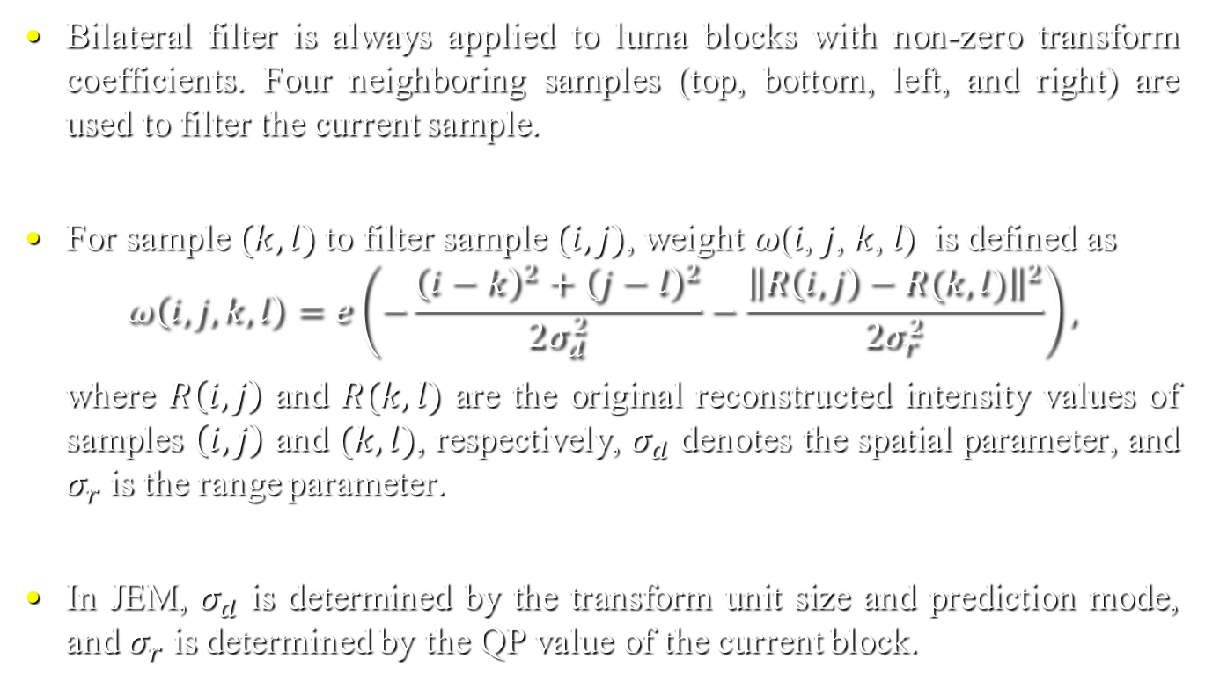
Bilateral filter
Bilateral filter is always applied to luma blocks with non-zero transform coefficients. Four neighboring samples (top, bottom, left, and right) are used to filter the current sample.
For sample $(k, l)$to filter sample $(i, j)$, weight 𝜔(𝑖, 𝑗, 𝑘, 𝑙) is defined as
$$ω\left(i, j, k, l\right)=e\left(−\frac{{\left(i−k\right)}^{2}+{\left(j−l\right)}^{2}}{2σ_{d}^{2}}−\frac{{\left\|R\left(i,j\right)−R(k,l)\right\|}^{2}}{2σ_{r}^{2}}\right),$$
where $R\left(i,j\right)$ and $R(k,l)$ are the original reconstructed intensity values of samples $\left(i,j\right)$ and $(k,l)$, respectively, $σ_{d}$ denotes the spatial parameter, and $σ_{r}$ is the range parameter.
In JEM, $σ_{d}$ is determined by the transform unit size and prediction mode, and $σ_{r}$ is determined by the QP value of the current block.
(19)

Slide 42
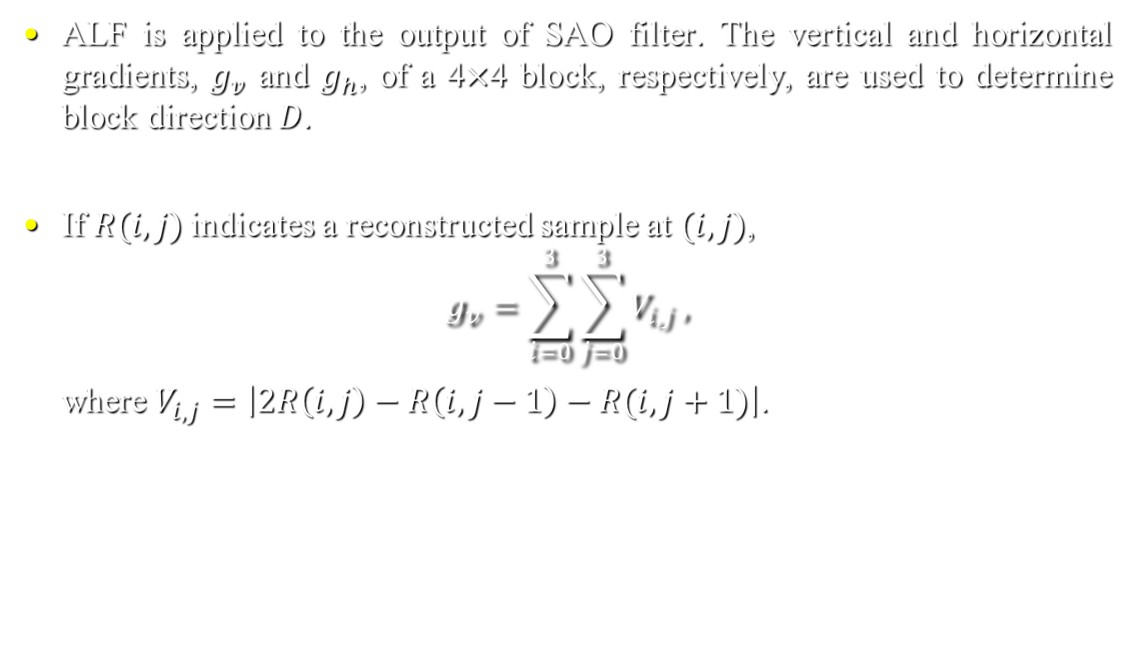
Adaptive loop filter (ALF)
ALF is applied to the output of SAO filter. The vertical and horizontal gradients, $g_{v}$ and $g_{h}$, of a 4$×$4 block, respectively, are used to determine block direction $D$.
If $R(i, j)$indicates a reconstructed sample at $(i, j)$,
$$g_{v}=\sum_{i=0}^{3}{\sum_{j=0}^{3}{V_{i,j}}},$$
where $V_{i,j}=\left|2R\left(i,j\right)−R\left(i,j−1\right)−R(i,j+1)\right|$.
(20)

Slide 43
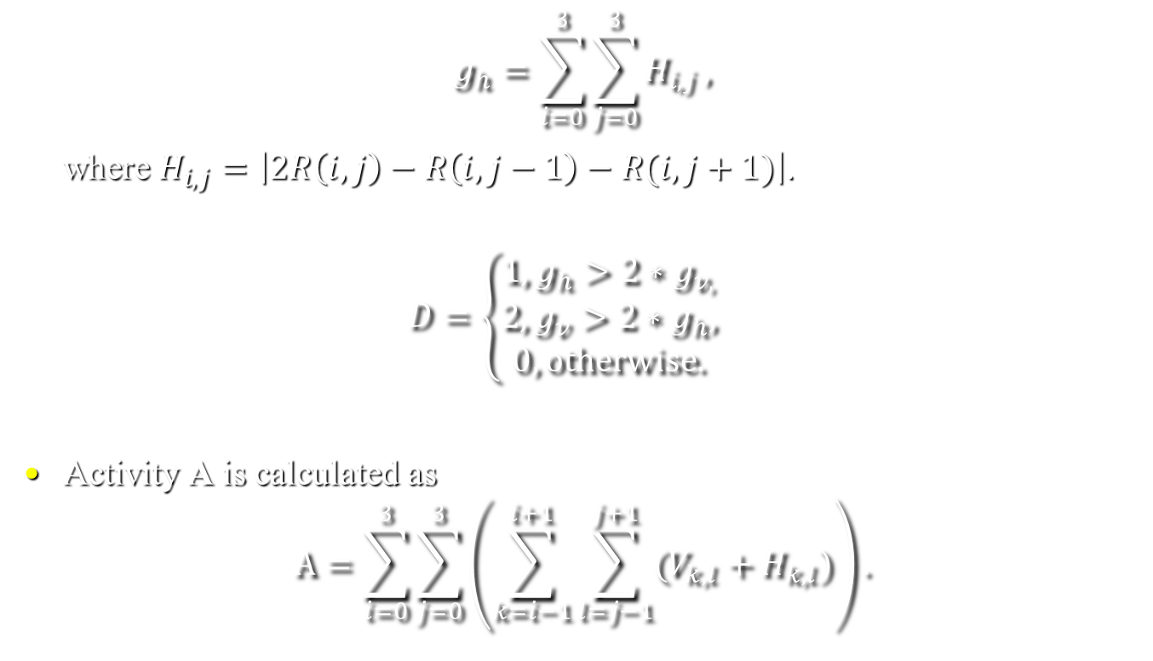
Adaptive loop filter (cont.)
$$g_{h}=\sum_{i=0}^{3}{\sum_{j=0}^{3}{H_{i,j}},}$$
where $H_{i,j}=\left|2R\left(i,j\right)−R\left(i,j−1\right)−R(i,j+1)\right|$.
$$D=\left\{\begin{aligned}1,g_{h}>2∗g_{v,} \\ 2,g_{v}>2∗g_{h}, \\ 0, otherwise.\end{aligned}\right.$$
Activity A is calculated as
$$A=\sum_{i=0}^{3}{\sum_{j=0}^{3}{\left(\sum_{k=i−1}^{i+1}{\sum_{l=j−1}^{j+1}{(V_{k,l}+H_{k,l})}}\right)}}.$$
(21)
(22)

Slide 44
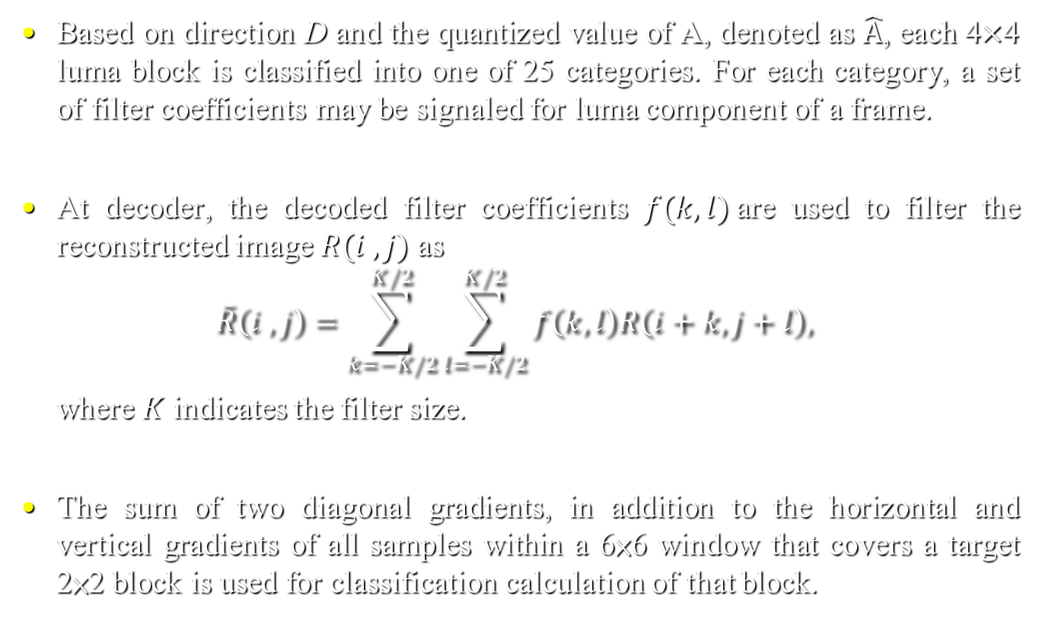
Adaptive loop filter (cont.)
Based on direction D and the quantized value of A, denoted as $\hat{A}$, each 4$×$4 luma block is classified into one of 25 categories. For each category, a set of filter coefficients may be signaled for luma component of a frame.
At decoder, the decoded filter coefficients $f(k, l)$are used to filter the reconstructed image $R(i , j)$ as
$$\tilde{R}\left(i , j\right)=\sum_{k=−K/2}^{K/2}{\sum_{l=−K/2}^{K/2}{f\left(k, l\right)R\left(i+k, j+l\right), }}$$
where $K$ indicates the filter size.
The sum of two diagonal gradients, in addition to the horizontal and vertical gradients of all samples within a 6×6 window that covers a target 2×2 block is used for classification calculation of that block.
(23)

Slide 45
Entropy coding
As compared with HEVC, CABAC in JEM contains the following two major changes:
Multi-hypothesis probability estimation with context-dependent updating speed
Modified context modeling for transform coefficients

Slide 46
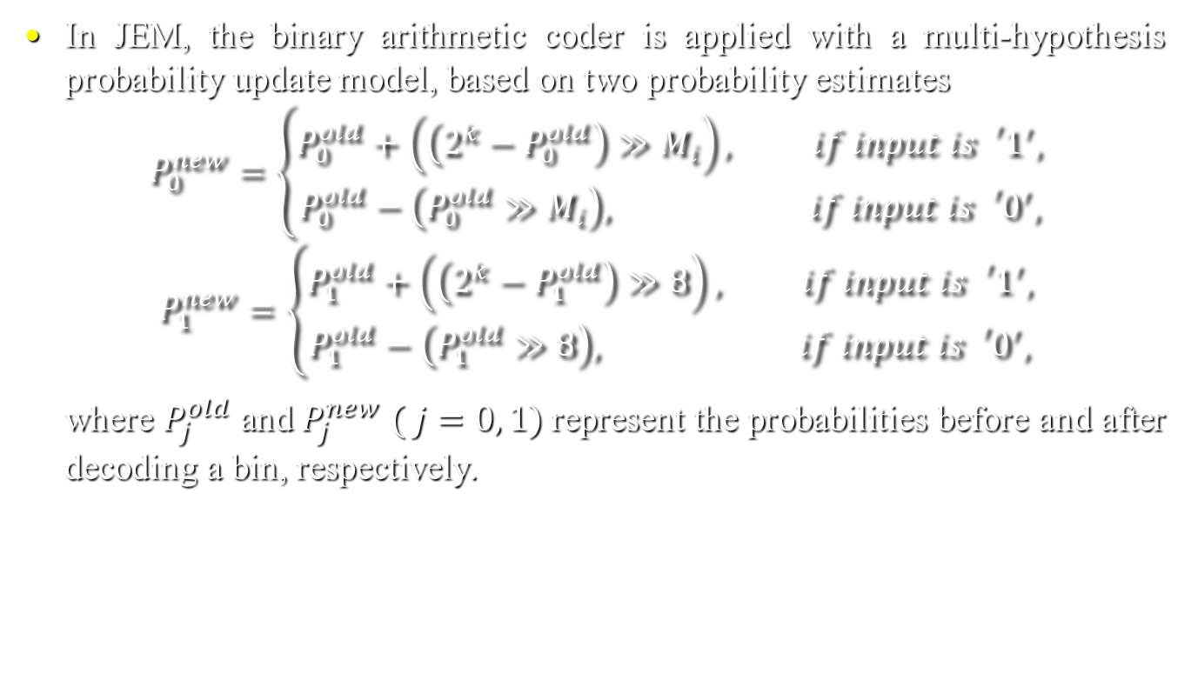
Multi-hypothesis probability estimation
In JEM, the binary arithmetic coder is applied with a multi-hypothesis probability update model, based on two probability estimates
$$P_{0}^{new}=\left\{\begin{aligned}P_{0}^{old}+\left(\left(2^{k}−P_{0}^{old}\right)≫M_{i}\right), if input is{{}_{}^{′}1}^{′}, \\ P_{0}^{old}−\left(P_{0}^{old}≫M_{i}\right), if input is{{}_{}^{′}0}^{′},\end{aligned}\right.$$
$$P_{1}^{new}=\left\{\begin{aligned}P_{1}^{old}+\left(\left(2^{k}−P_{1}^{old}\right)≫8\right), if input is{{}_{}^{′}1}^{′}, \\ P_{1}^{old}−\left(P_{1}^{old}≫8\right), if input is{{}_{}^{′}0}^{′},\end{aligned}\right.$$
where $P_{j}^{old}$ and $P_{j}^{new}$ $( j=0, 1)$represent the probabilities before and after decoding a bin, respectively.
(41)
(42)

Slide 47

Multi-hypothesis probability estimation (cont.)
Variable $M_{i}$ (being 4, 5, 6, 7) is a parameter which controls the probability updating speed for the i-th context model.
The probability estimate P used for interval subdivision in the binary arithmetic coder is
$P=\left(P_{0}^{new}+P_{1}^{new}\right)/2.$
(43)

Slide 48
Context modeling for transform coefficients
In HEVC, transform coefficients of a coding block are coded using non-overlapped coefficient groups (CGs), and each CG contains the coefficients of a 4×4 block of a coding block [37].
In JEM, the context modeling for context coded bins is changed. When coding bin i in the i-th scan pass (i being 0, 1, 2), the context index is determined by the sum of the i-th bins of neighboring coefficients.
To capture the characteristics of transform coefficients at different frequencies, one coding block may be split into up to three regions.
For example, as shown in Fig. 10, when coding bin0 of luma transform coefficients, one coding block is split into three regions marked with different shadings and different context indexes.

Slide 49
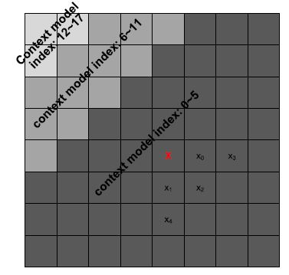
Context modeling for transform coefficients (cont.)
Compared to the position-based context modeling used in HEVC, the template-based context modeling in JEM takes neighboring coefficients into consideration, resulting in more effective compression.
Fig. 10

Slide 50
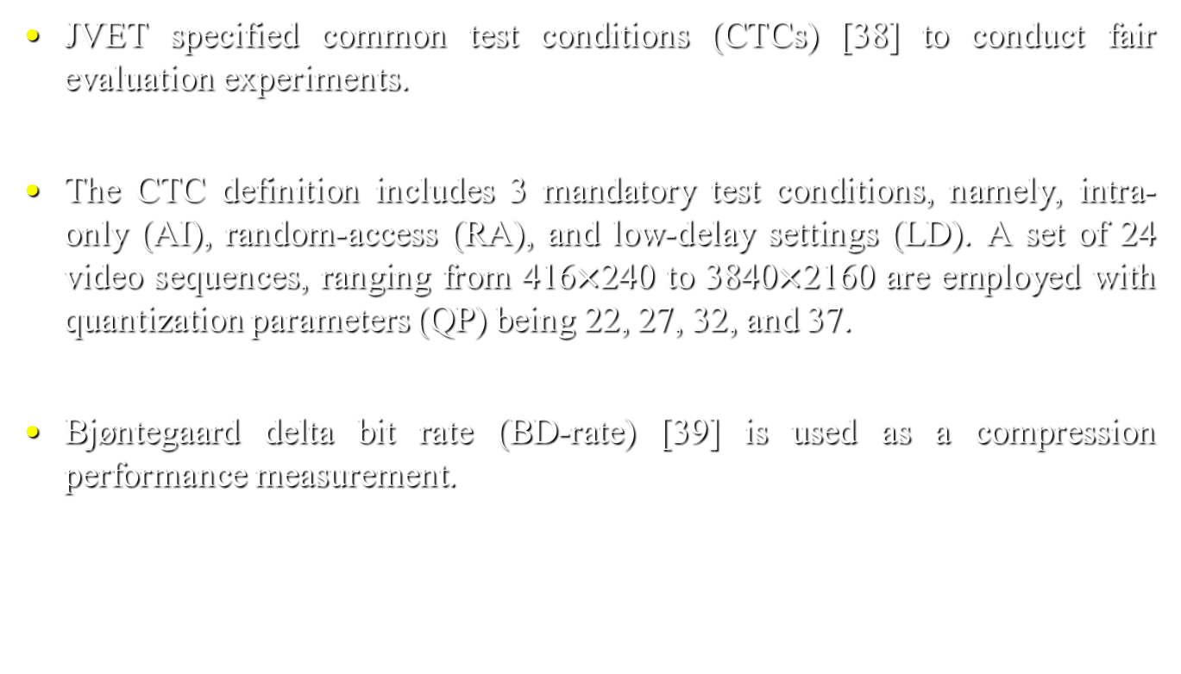
Coding performance and complexity
JVET specified common test conditions (CTCs) [38] to conduct fair evaluation experiments.
The CTC definition includes 3 mandatory test conditions, namely, intra-only (AI), random-access (RA), and low-delay settings (LD). A set of 24 video sequences, ranging from 416$×$240 to 3840$×$2160 are employed with quantization parameters (QP) being 22, 27, 32, and 37.
Bjøntegaard delta bit rate (BD-rate) [39] is used as a compression performance measurement.

Slide 51
Rate-distorition performance of JEM
The coding results of JEM7.0 [40] are compared to those of HEVC HM16.16 [41].
JEM provides the best coding gain in RA configurations, where JEM achieves 28.5% luma BD-rate saving and more BD-rate savings for chroma components, due to CCLM and luma-chroma separate QTBT structures.
For AI and LD configurations, JEM achieves 19.7% and 22.3% luma BD-rate savings, respectively.

Slide 52
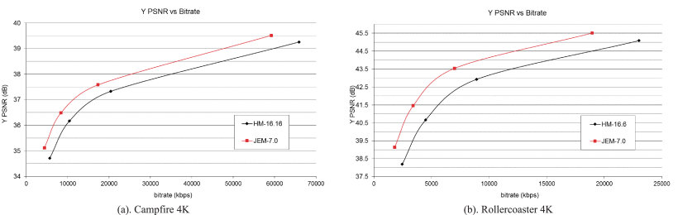
Rate-distorition performance of JEM (cont.)
Two R-D curves of JEM7.0 and HEVC HM16.16.

Slide 53
Rate-distorition performance of JEM (cont.)
Table VI. BD-rate savings of JEM7.0 over HEVC HM16.16.
Class | Sequences | All Intra |  |  | Random Access |  |  | Low Delay B
 |  | Y BD-rate | U BD-rate | V BD-rate | Y BD-rate | U BD-rate | V BD-rate | Y BD-rate | U BD-rate | V BD-rate
Class A1 4K | Tango2 | -22.70% | -47.60% | -44.10% | -34.80% | -54.50% | -49.60%
 | DrumslOO | -18.20% | -19.80% | -22.40% | -30.40% | -28.80% | -33.10%
 | Campfire | -25.30% | -43.00% | -32.40% | -28.90% | -34.90% | -47.30%
 | ToddlerFountain2 | -15.40% | -20.60% | -11.70% | -14.80% | -14.30% | -10.80%
Class A2 4K | CatRobot | -23.30% | -30.20% | -31.10% | -38.60% | -48.30% | -40.50%
 | TrafficFlow | -26.50% | -40.20% | -33.10% | -28.90% | -45.70% | -38.70%
 | DaylightRoad2 | -19.90% | -39.80% | -18.30% | -38.90% | -44.10% | -31.10%
 | Rollercoaster2 | -24.80% | -29.10% | -27.90% | -38.70% | -42.90% | -42.80%
 | Kimono | -18.00% | -21.50% | -13.00% | -22.20% | -28.90% | -17.90% | -15.70% | -23.50% | -17.10%
Class B 1080p | ParkScene | -17.00% | -24.60% | -8.60% | -21.10% | -29.00% | -14.80% | -15.00% | -15.70% | -15.20%
 | Cactus | -19.10% | -18.10% | -23.20% | -32.00% | -39.80% | -32.00% | -25.80% | -32.40% | -31.00%
 | BasketballDrive | -19.80% | -36.90% | -37.60% | -30.30% | -43.10% | -42.30% | -24.50% | -39.00% | -38.50%
 | BQTerrace | -15.10% | -27.20% | -37.50% | -29.40% | -44.10% | -51.70% | -23.10% | -32.60% | -34.90%
Class C WVGA | BasketballDrill | -29.40% | -38.70% | -41.50% | -29.10% | -37.10% | -38.70% | -24.10% | -36.80% | -39.60%
 | BQMall | -18.50% | -28.60% | -31.60% | -28.10% | -34.40% | -36.20% | -21.80% | -27.30% | -28.80%
 | PartyScene | -14.00% | -21.60% | -23.30% | -25.10% | -30.50% | -32.60% | -20.70% | -22.00% | -23.50%
 | RaceHorses | -16.40% | -13.40% | -19.30% | -23.10% | -23.00% | -27.10% | -19.10% | -18.50% | -23.10%
Class D WQVGA | BasketballPass | -17.80% | -28.50% | -24.90% | -24.40% | -36.90% | -32.70% | -19.60% | -32.10% | -27.90%
 | BQSquare | -12.80% | -15.60% | -21.30% | -32.90% | -31.00% | -36.90% | -30.50% | -20.00% | -25.40%
 | BlowingBubbles | -14.40% | -19.30% | -20.10% | -23.50% | -26.00% | -27.90% | -20.10% | -21.10% | -23.00%
 | RaceHorses | -17.80% | -20.00% | -22.40% | -23.30% | -26.30% | -28.50% | -19.40% | -21.80% | -23.10%
ClassE 720p | FourPeople | -21.90% | -29.00% | -30.60% |  |  |  | -22.80% | -31.00% | -34.50%
 | Johnny | -22.00% | -30.40% | -34.90% |  |  |  | -27.90% | -41.40% | -42.70%
 | Kristen And Sara | -22.20% | -27.70% | -30.80% |  |  |  | -27.20% | -35.40% | -38.50%
Average |  | -19.70% | -28.00% | -26.70% | -28.50% | -35.40% | -34.00% | -22.30% | -28.20% | -29.20%

Slide 54
Rate-distorition performance of JEM (cont.)
The encoder runtime of JEM7.0 is around 10 times that of HEVC HM16.16 on average in both RA and LD configurations. The encoder runtime of JEM7.0 is around 35 times larger on average compared to that of HEVC HM16.16 in AI configuration.
The decoder runtime of JEM7.0 is around 2.4 times larger on average compared to that of HEVC HM16.16 in AI configurations. The decoder runtime of JEM7.0 is around 7 times in average compared to that of HEVC HM16.16 in both RA and LD configurations.

Slide 55
Rate-distorition performance of JEM (cont.)
Table VII. Runtime of JEM7.0 over HEVC HM16.16.
Class | All Intra |  | Random Acces |  | Low Delay B
 | EncT | DecT | EncT | DecT | EncT | DecT
Class A1 | 3093% | 206% | 1079% | 563%
Class A2 | 2555% | 202% | 787% | 609%
Class B | 3284% | 199% | 883% | 639% | 903% | 543%
Class C | 4845% | 259% | 1137% | 788% | 1193% | 728%
Class D | 5470% | 410% | 1153% | 1171% | 1102% | 1074%
Class E | 2837% | 226% |  |  | 453% | 600%
Overall | 3556% | 240% | 991% | 722% | 894% | 706%

Slide 56
Individual tool simulation
The BD-rate saving and runtime of a list of tools in JEM7.0 with both tool-on and tool-off test conditions for RA configuration are tabulated in Table VIII.
As shown in Table VIII, all listed tools show more than 2% luma BD-rate saving in tool-on condition.

Slide 57
Individual tool simulation (cont.)
Table VIII. Coding performance of individual tools in JEM7.0 for RA configuration.
Tested tool | "tool-on" results |  |  |  |  | "tool-off" results
 | BD-rate |  |  | Runtime |  | BD-rate |  |  | Runtime
 | Y | U | V | EncT | Dec | Y | U | V | EncT | Dec
QTBT | -6.0% | -13.9% | -15.3% | 158% | 106% | N/A | N/A | N/A | N/A | N/A
CCLM | -2.8% | -5.8% | -6.9% | 101% | 98% | -1.7% | -24.1% | -29.2% | 100% | 98%
AMVR | -2.2% | -2.7% | -2.9% | 117% | 95% | -1.0% | -1.4% | -1.5% | 111% | 97%
AFFINE | -2.7% | -2.2% | -2.2% | 135% | 107% | -1.2% | -1.0% | -1.1% | 105% | 101%
DMVR | -2.6% | -2.5% | -2.5% | 105% | 128% | -0.3% | -0.4% | -0.4% | 101% | 100%
BIO | -2.3% | -0.8% | -0.5% | 113% | 187% | -1.1% | -0.2% | -0.1% | 115% | 147%
PMMVD | -6.1% | -5.8% | -5.9% | 119% | 180% | -3.8% | -3.8% | -4.1% | 125% | 130%
AMT | -3.0% | -0.7% | -0.5% | 135% | 99% | -2.6% | -0.6% | -0.9% | 130% | 99%
NSST | -2.5% | -5.1% | -5.4% | 111% | 100% | -1.7% | -3.6% | -4.0% | 119% | 99%
ALF | -5.8% | -2.3% | -1.7% | 111% | 175% | -5.0% | -2.8% | -2.0% | 101% | 115%

Slide 58
Individual tool simulation (cont.)
For QTBT, as compared to HEVC HM16.16 block structure, 6% luma BD-rate saving is achieved with reasonable encoding time increase.
It provides more chroma gain with the separate Luma and Chroma block partitioning tree method.
The CCLM method achieves significant chroma gain as well as remarkable luma BD-rate saving.

Slide 59
Current status of JEM coding algorithms
The further work of JEM focuses on either complexity reduction or achieving even more compression gain.
At the current stage, most JEM coding tools have been adopted in the latest VVC (H.266) test model and working draft text [43].

